Slide 1

Web Service Testing
SOAP-based Web Services
Software Quality Assurance
Telerik Software Academy
http://academy.telerik.com
Notes:
http://www.ebizq.net/topics/soa_management/features/3307.html?page=1

Slide 2


The Lectors
Snejina Lazarova
Product Manager
Talent Management System
Dimo Mitev
QA Architect
Backend Services Team

Slide 3

Table of Contents
Web Service Testing – Main Concepts
SoapUI
SoapUI – Introduction
Functional testing with SoapUI
Load testing with SoapUI
Advanced scripting with groovy

Slide 4
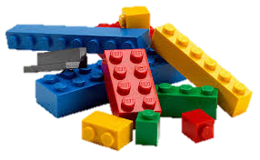
Web Service Testing
Main Concepts

Slide 5

Web Apps vs. Web Services
Web Applications are designed to be accessed by end users through Web client software
Web Services are intended to be used by other software applications

Slide 6

What are Web Services?
“A software system designed to support interoperable machine-to-machine interaction over a network… “
W3C definition

Slide 7

Why Web Services?
Connect existing software
Reuse application components

Slide 8

Connectivity
Connecting existing software
Web services help solve the interoperability problem
Giving different applications a way to link their data
Using Web services you can exchange data between different applications and different platforms

Slide 9

Reusability
Web Services make application components reusable
Ideally, there will only be one type of each application component, and anyone can use it in their application

Slide 10
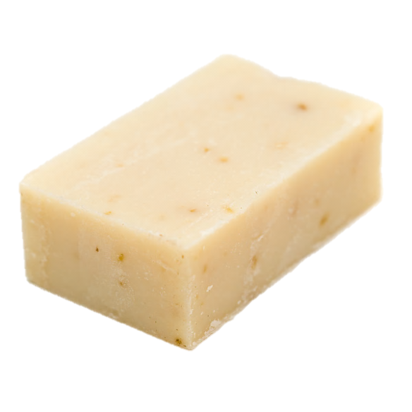
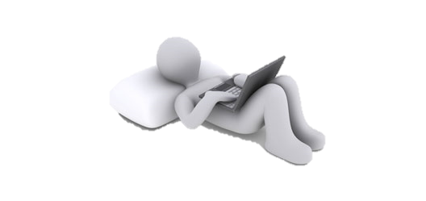
Types of Web Services?
SOAP-based Web Services
RESTful Web Services

Slide 11

SOAP-based Web Service Testing

Slide 12
Web Services
Web services take Web applications to the next level
Using Web services your application can publish its function or message to the rest of the world
Soap Web services use:
XML
To code and decode your data and
SOAP
To transport it using open protocols

Slide 13
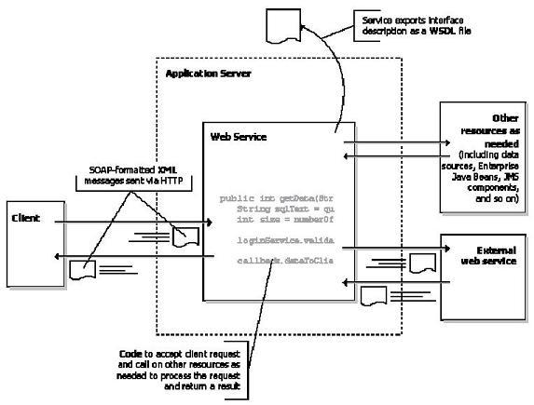
Web Service Architecture

Slide 14
The Base of WS
The basic Web services platform is XML + HTTP
HTTP
The most used Internet protocol
XML
Provides a language which can be used between different platforms and programming languages
Still expresses complex messages and functions

Slide 15

Web Services Platform Elements
SOAP
Simple Object Access Protocol
WSDL
Web Services Description Language

Slide 16
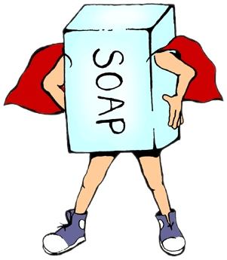
What is SOAP?
SOAP stands for Simple Object Access Protocol
SOAP is:
A communication protocol
Serves for communication between applications
A format for sending messages
Designed to communicate via Internet
Platform independent
Language independent
Based on XML
Simple and extensible
Allows you to get around firewalls
Will be developed as a W3C standard

Slide 17
What is WSDL?
WSDL is an XML-based language
Serves for describing Web services and how to access them
WSDL:
WSDL stands for Web Services Description Language
WSDL is written in XML
WSDL is an XML document
WSDL is used to describe Web services
WSDL is also used to locate Web services
WSDL is not yet a W3C standard

Slide 18
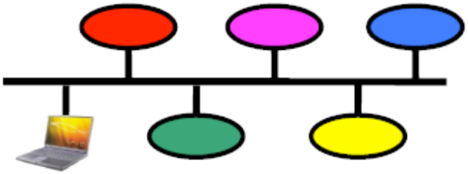
Web Service Testing Challenges
Since Web services are composed of loosely coupled distributed over networks, we must test the application:
End to end
Service to service
Interface by interface
Notes:
http://www.cs.colorado.edu/~kena/classes/7818/f06/lectures/WebTest.pdf

Slide 19
How to Test a Web Service?
A web service has no user interface
We can’t interact with it without a special tool
That tool should allow composing XML requests via its own user interface
Commonly such user interfaces are text editors
Used for writing your XML requests and controls for posting requests to the server

Slide 20
Web Service Test Automation
What if your web service contains too many methods?
With too many input and output parameters
Web Service testing can be automated
Automate validation of your web service’s response against you input
Automate the output of validation results into a file
Could be just a text file of HTML depending on your choice

Slide 21

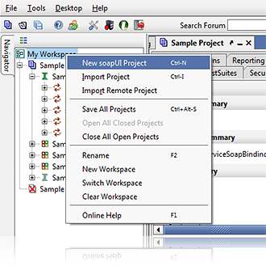
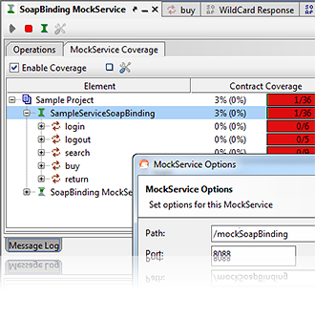
soapUI

Slide 22


What is soapUI?
What is SoapUI?
Java-based cross-platform Functional Testing solution
Has two editions:
Free and open-source
Paid version – SoapUI Pro
Source: http://www.soapui.org

Slide 23
SoapUI Features
SoapUI provides various options for testing web services:
Functional testing
Load testing
Service Simulation (Mocking)
Security testing
REST testing

Slide 24
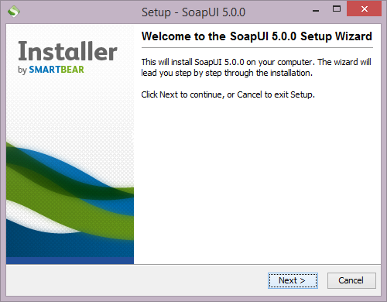
Installing SoapUI
Short Demo

Slide 25
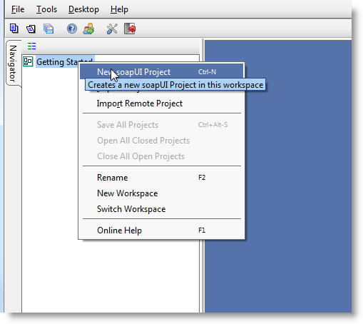
Creating a SoapUI Project
Demo
For detailed tutorial see: http://www.soapui.org/Getting-Started/your-first-soapui-project.html

Slide 26
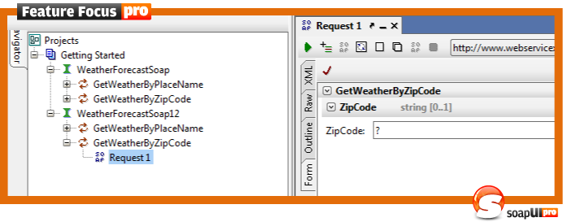
Functional Testing with SoapUI
Demo
For detailed tutorial see: http://www.soapui.org/Getting-Started/your-first-soapui-project.html

Slide 27
SoapUI Assertions
Examples of assertions that are possible in SoapUI are:
Schema Compliance
Simple Contains
Simple Not Contains
SOAP Fault
Not SOAP Fault
SOAP Response
Response SLA
XPath Match
XQuery Match
Script Assertion
WS-Security Status
WS-Addressing Response Assertion
WS-Addressing Request Assertion

Slide 28
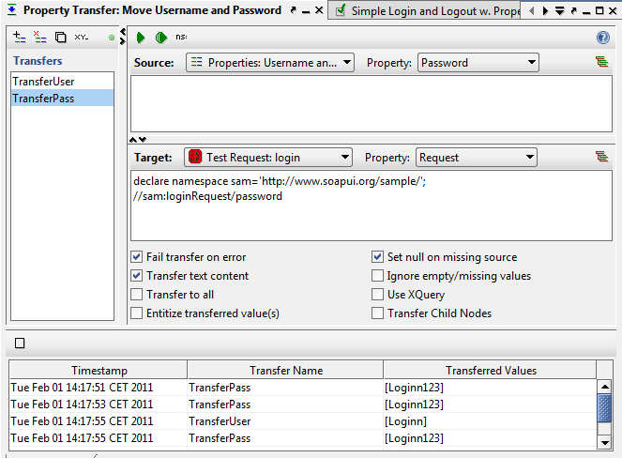
Property Transfer
What is Property Transfer in SoapUI?
Transferring data from a response to a following request

Slide 29
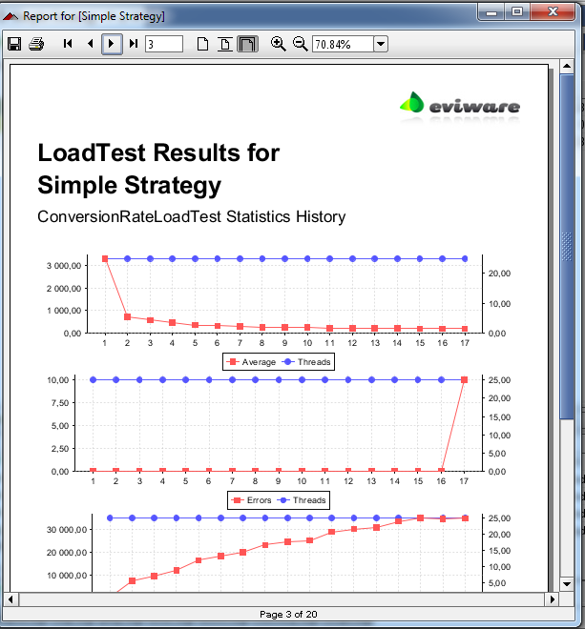
Load Testing with SoapUI
What soapUI calls "Load Testing" is actually a "Performance Testing"
SoapUI offers an example of a Performance Testing categorization:
Baseline Testing
Load Testing
Stress Testing
Soak Testing
Scalability Testing
Notes:
See: http://www.soapui.org/Load-Testing/concept.html

Slide 30
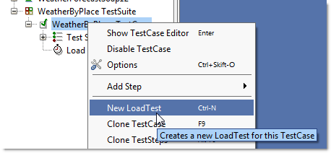
Load Testing with SoapUI
Demo
For detailed tutorial see: http://www.soapui.org/Getting-Started/load-testing.html

Slide 31

Advanced Scripting with Groovy

Slide 32
Advanced Scripting with Groovy
SoapUI uses a central library of Groovy scripts
What is Groovy?
An agile and dynamic language for the Java Virtual Machine
Builds upon the strengths of Java but has additional power features
Inspired by languages like Python, Ruby and Smalltalk
See: http://groovy.codehaus.org/

Slide 33

Using Groovy with SoapUI
Demo

Slide 34
SOAP-based Web Service Testing
?
?
?
?
?
Questions?
?
?
?
?
?
?

Slide 35




Free Trainings @ Telerik Academy
C# Programming @ Telerik Academy
csharpfundamentals.telerik.com
Telerik Software Academy
academy.telerik.com
Telerik Academy @ Facebook
facebook.com/TelerikAcademy
Telerik Software Academy Forums
forums.academy.telerik.com

